Slide 1
A HOLISTIC APPROACH
Mexico as a country of:
Emigration (forced and voluntary)
Transit
Asylum/Immigration
Return/Deportation
Internal Displacement
Holistic vision / policies / laws / programs that reflect this reality in discourse.
Implementation lags
-lack of inter-institutional collaboration, political will
-lack of infrastructure, resources
-limited channels for migrants and civil society to fully participate in design,
implementation and evaluation
-stigmatization and discrimination

Slide 2

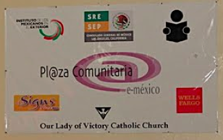
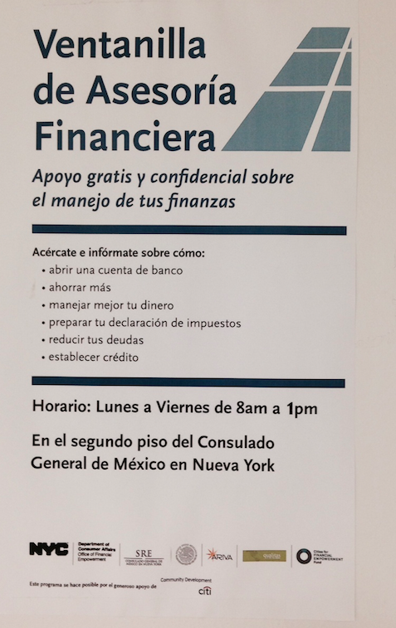
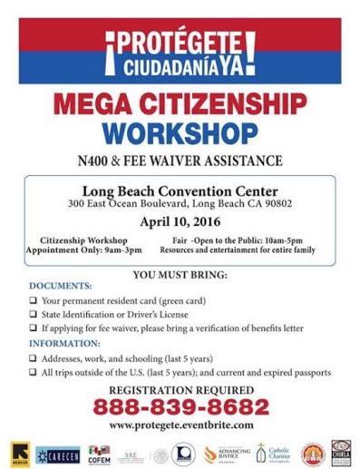
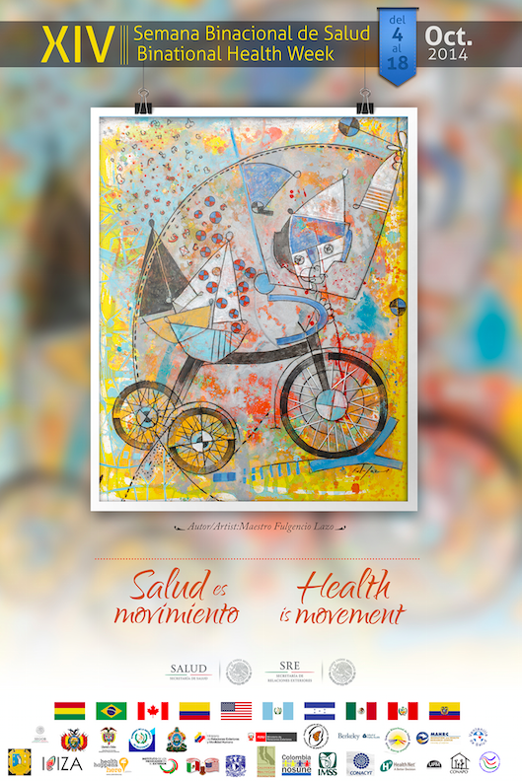
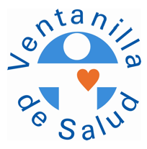

EXAMPLES OF HOLISTIC AND COLLABORATIVE APPROACHES
Build on initiatives developed by migrant organizations.
Partnerships with public and private institutions in US and Mexico + other countries;
Safe/trusted spaces with cultural/linguistic sensitivity, especially for populations with precarious status.

Slide 3
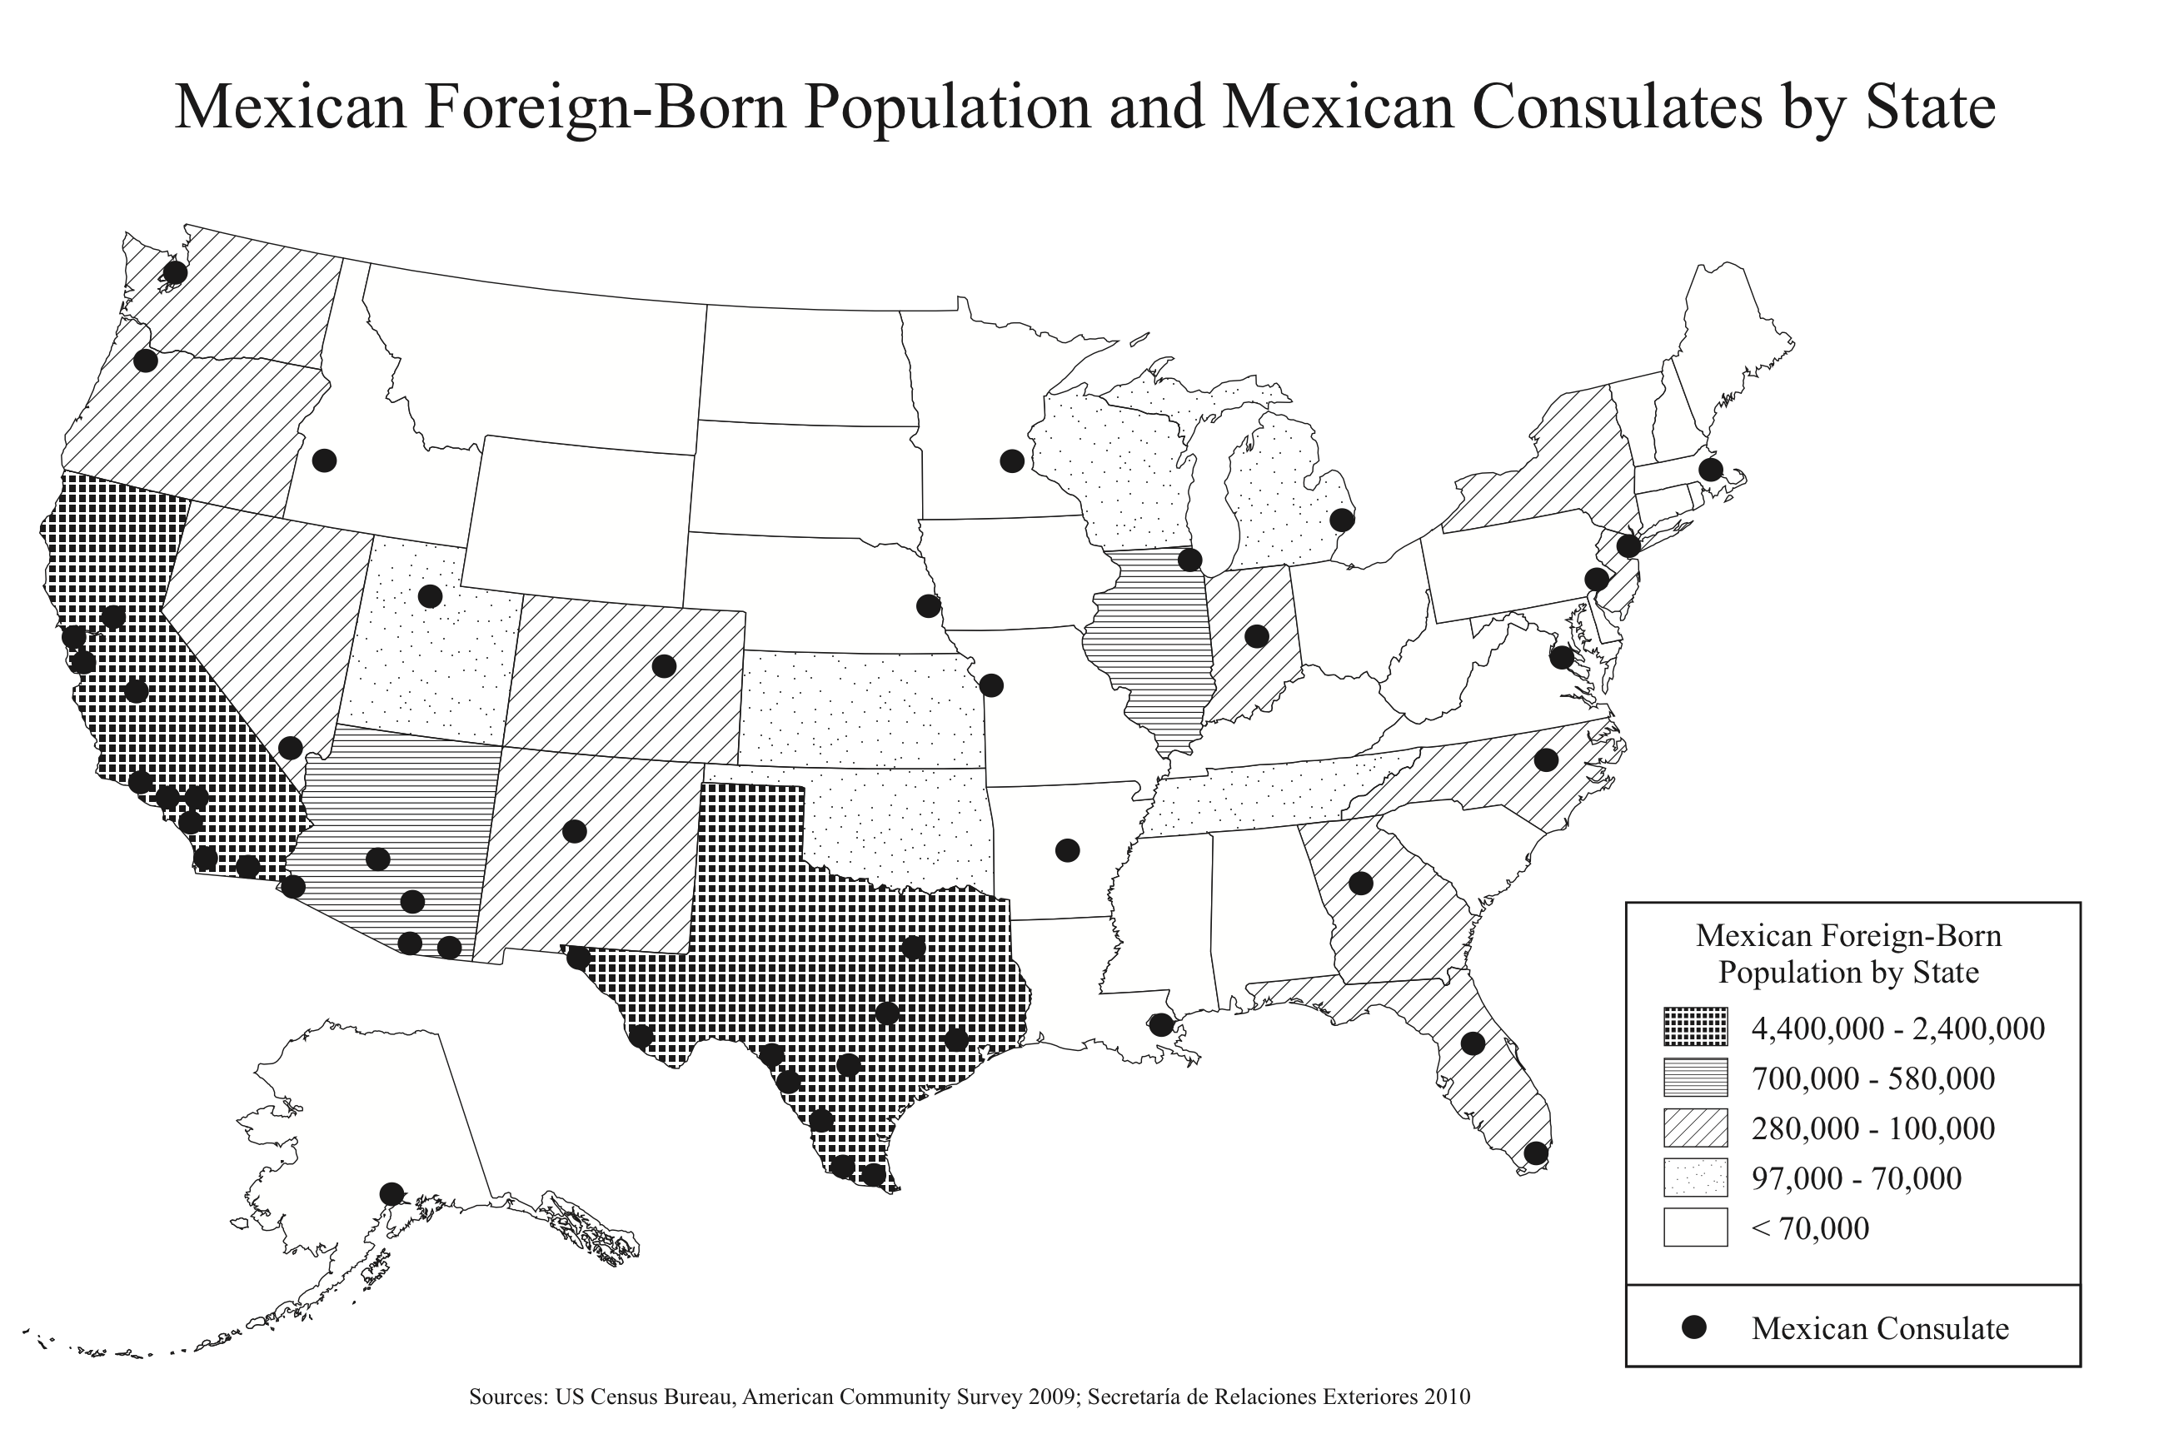
CONSULATES AS INTEGRATION CENTERS
“Taking into consideration that our ultimate goal is that Mexicans and Latinos in the United States fully integrate, participate and thrive in their communities, it is only natural that we support them in their path to gain full access to civic, social, economic and political rights.
With this objective in mind, our consulates have truly become integration centers where migrants have access to a wide array of services and programs, from matrículas consulares and passports, to health information and financial literacy programs. We have transcended traditional consular services in order to empower our community while helping them to stay in touch with Mexico.”
Eduardo Medina Mora, Mexican Ambassador to the United States, speech at NALEO Annual conference, June 28, 2014.

Slide 4
OPPORTUNITIES/CHALLENGES/CONTRADICTIONS
Shared responsibility/Governance:
Change perceptions about migrant populations and paths to integration. Not only compatible but can be enhanced through engagement with origin country.
A “Latin American” Agenda
Vs discourse of return / circularity
History of failed return policies “Que se queden allá”
Exclusion
Lack of institutional development in Mexico
Structural conditions
Growing (although still limited) attention to consular programs promoting access to health, education and other social services.

Slide 5
MOBILIZATION, ORGANIZATION AND ACCOUNTABILITY
Otros Dreams en Acción, Deportados Unidos en la Lucha, Dream in Mexico, Espacio Migrante…
Youth-led organizations
Vision and practice “From here and there” / “De aquí y de allá”
Migration as process.
Addresing broader challenges (mutuality/accompaniment/solidarity)
Challenges – translating practice into new context
- Building transnational ties

Slide 6

Thank you. Gracias. delanoa@newschool.edu @ale_delano www.makesanctuary.org

